Slide 1
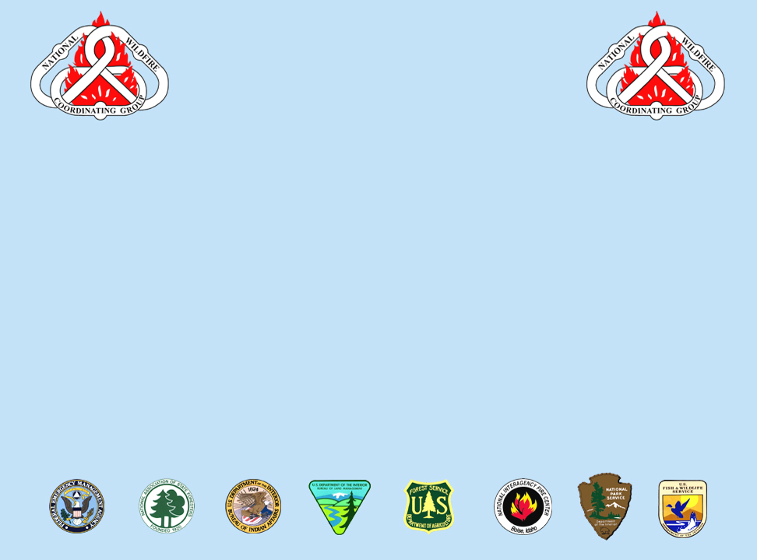
National Wildfire
Coordinating Group
Mission Statement
The purpose of NWCG is to coordinate programs of the participating wildfire management agencies to avoid wasteful duplication and to provide a means of constructively working together. The goal is to provide more effective execution of each agency’s fire management program. The group provides a formalized system to agree upon standards of training, equipment, qualifications, and other operational functions.
E-mail comments or suggestions pertaining to this
or any NWCG course to: BLM_FA_NWCG_Training@blm.gov
NWCG Website: http://www.nwcg.gov/

Slide 2
Expanded Dispatch Recorder
D-110
00-2-D110-EP

Slide 3

Course Objectives
Describe the purpose and structure of Expanded Dispatch.
Describe the roles and responsibilities of the Expanded Dispatch Recorder (EDRC).
D-110 Unit 0: Expanded Dispatch Recorder

Slide 4
Course Objectives
Demonstrate how to mobilize and demobilize incident resources, using established dispatch ordering channels, through resource order forms and electronic resource tracking systems.
Describe how to communicate effectively and foster positive interpersonal working relationships.
D-110 Unit 0: Expanded Dispatch Recorder

Slide 5
Unit Overview
Unit 0 Introduction
Unit 1 Dispatch Organization
Unit 2 Communications and Working Relationships
Unit 3 Getting Acquainted with Electronic Resource Tracking System (IROC)
D-110 Unit 0: Expanded Dispatch Recorder

Slide 6
Unit Overview
Unit 4 Creating a Resource Request, Pending Request, Resource Status, and Edit Request
Unit 5 Filling and Placing a Request, DPL, Mobilizing, and Travel/Travel Procedures
Unit 6 Request Status, Support and Subordinate Requests
D-110 Unit 0: Expanded Dispatch Recorder

Slide 7
Unit Overview
Unit 7 Supplies
Unit 8 Supply Resource Orders
Unit 9 Supplemental Forms and Manual Resource Ordering
Unit 10 Demobilization
Unit 11 Final Scenario and Exam
Unit 12 After Action Review (AAR) and Closeout
D-110 Unit 0: Expanded Dispatch Recorder

Slide 8
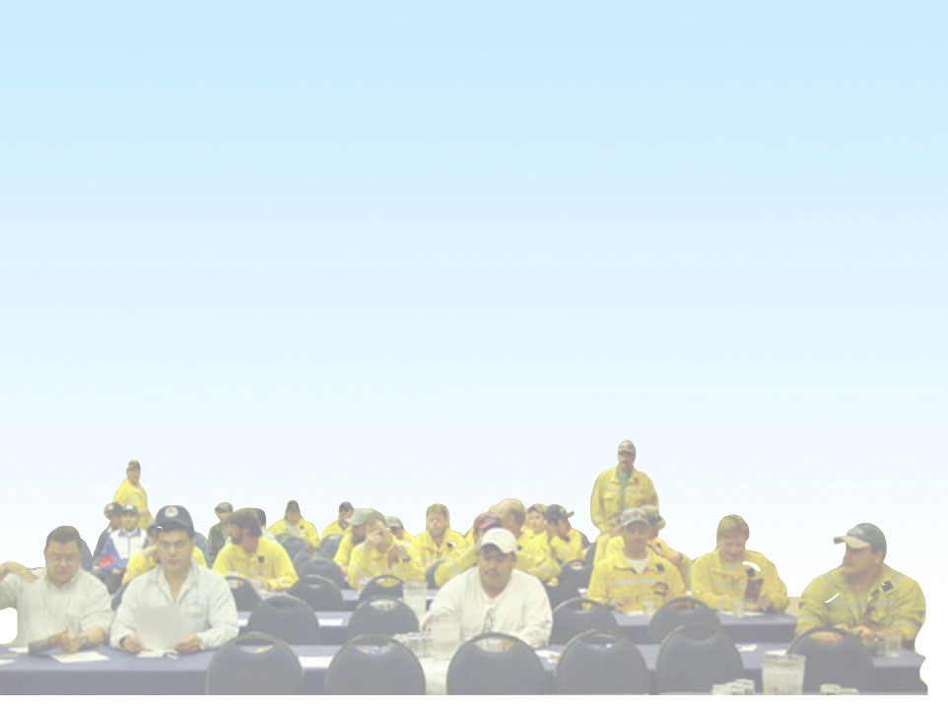
Instructional Methods
Electronic presentations, demonstrations, short lectures, handouts, and a series of progressive hands-on electronic resource tracking system (IROC) exercises.
Reference material provided electronically and hardcopy
D-110 Unit 0: Expanded Dispatch Recorder

Slide 9
Responsibilities
Students
  Actively Participate
  Ask Questions
  Take Notes
  Be Flexible
  Complete Unit Evaluations
Coaches
  Provide Clarification and Guidance
  Ensure Data is Entered Correctly
  Evaluate Student Performance
D-110 Unit 0: Expanded Dispatch Recorder

Slide 10
Responsibilities
Instructors
  Demonstrate electronic resource tracking system (IROC) screens
  Explain Dispatch Concepts
  Assist Coaches and Students
D-110 Unit 0: Expanded Dispatch Recorder

Slide 11
Measuring Performance
Brainstorming and Discussions
  Participation is Required
IROC Exercises
  Additional Hands-on Time Can Be Requested with Coach
Criteria For Passing Course: 70% or higher on final exam
D-110 Unit 0: Expanded Dispatch Recorder

Slide 12
Course Materials
Laptop or Computer with Internet and Printer Access
Student Workbook
References, Guides, and Standard Operating Procedures
D-110 Unit 0: Expanded Dispatch Recorder

Slide 13
Complete
Course Evaluation
Forms
D-110 Unit 0: Expanded Dispatch Recorder

